Slide 1
CSE 220
Jannatun Noor
Jannatun.noor@bracu.ac.bd
Lecture Made by: Aminul Huq

Slide 2
Array Disadvantages
1) The size of the array is fixed — 100 elements in this case. Most often this size is specified at compile time with a simple declaration such as in the example above .
2) Because of (1), the most convenient thing for programmers to do is to allocate arrays which seem "large enough" (e.g. the 100 in the scores example).
3) (minor) Inserting new elements at the front is potentially expensive because existing elements need to be shifted over to make room.

Slide 3
Linked List
the linked list data structure is a sequence of nodes connected by links
The links allow inserting new nodes anywhere in the list or to remove an existing node from the list without having to disturb the rest of the list
Since we can extend the list one node at a time, we can also resize a list until we run out of resources.
Linked list is a sequence container that supports sequential access only, and requires additional space for at least n references for the links.

Slide 4
Linked List
We maintain a linked list by referring to the first node in the list, conventionally called the head reference. All the other nodes can then be reached by traversing the list, starting from the head. An empty list is represented by setting the head reference to the null. Given a head reference to a list, how do you count the number of nodes in the list? You have to iterate over the nodes, starting from head, and count until you reach the end.

Slide 5
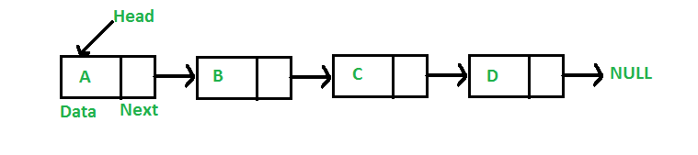
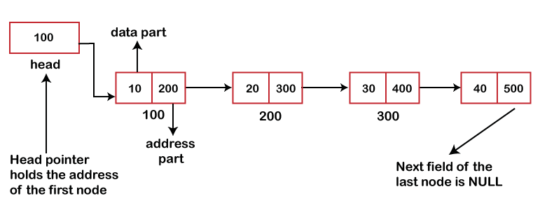
Linked List

Slide 6
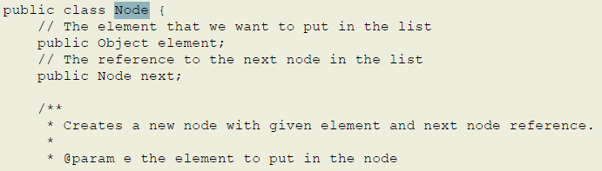
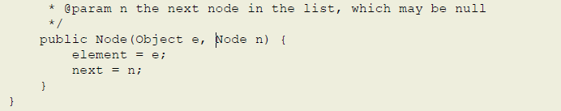

Slide 7
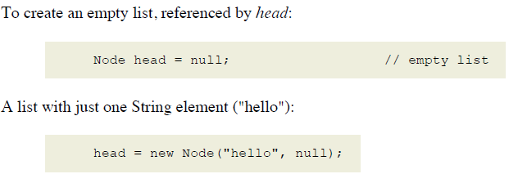
Creating a list of elements

Slide 8
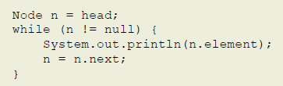

Iterating over the elements
To iterate over the elements of a list, we start at the head node, and then advance one node at a time. For example, the following prints out each element (stored within the nodes) in the list.

Slide 9
Types of Linked List
Following are the various types of linked list.
Simple Linked List − Item navigation is forward only.
Doubly Linked List − Items can be navigated forward and backward.
Circular Linked List − Last item contains link of the first element as next and the first element has a link to the last element as previous.

Slide 10
Basic Operations
Following are the basic operations supported by a list.
Insertion − Adds an element at the beginning of the list.
Deletion − Deletes an element at the beginning of the list.
Display − Displays the complete list.
Search − Searches an element using the given key.
Delete − Deletes an element using the given key.

Slide 11
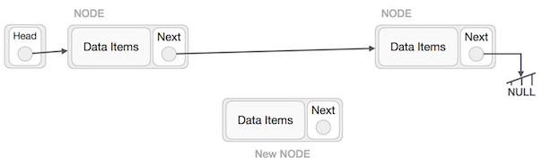
Insertion
Adding a new node in linked list is a more than one step activity. We shall learn this with diagrams here. First, create a node using the same structure and find the location where it has to be inserted.

Slide 12
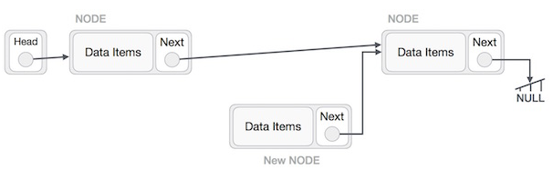
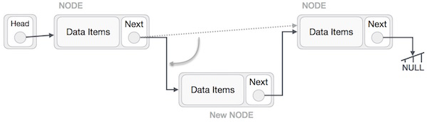
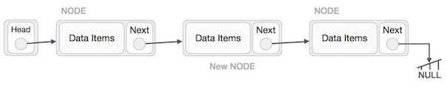

Slide 13
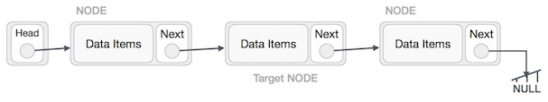
Deletion
Deletion is also a more than one step process. We shall learn with pictorial representation. First, locate the target node to be removed, by using searching algorithms.

Slide 14
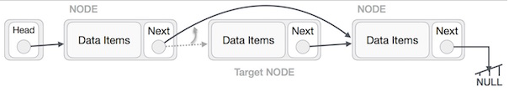
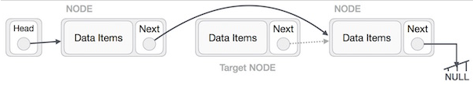
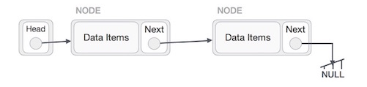

Slide 15
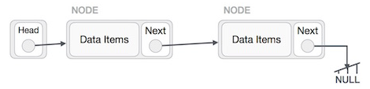
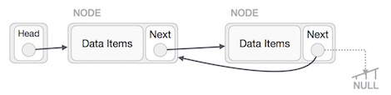
Reverse
This operation is a thorough one. We need to make the last node to be pointed by the head node and reverse the whole linked list.

Slide 16
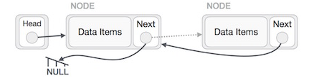
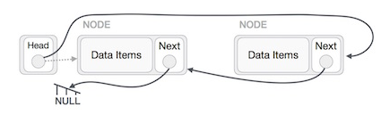
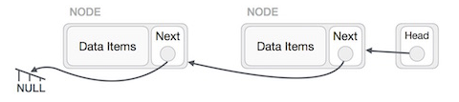

Slide 17
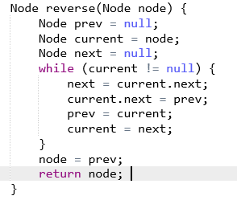
500
1000
2000
3000
85 | 1000
15 | 2000
4 | 3000
20 | Null
Prev | Current | Next | Current.next
Null | Node(500) | Null
Null | Node(500) | 1000
Null | Node(500) | 1000 | Null
Node(500) | Node(500) | 1000 | Null
Node(500) | 1000 | 1000 | Null
Node(500) | 1000 | 2000 | Null
Node(500) | 1000 | 2000 | Node(500)
1000 | 1000 | 2000 | Node(500)
1000 | 2000 | 2000 | Node(500)
Prev | Current | Next | Current.next
1000 | 2000 | 3000 | Node(500)
1000 | 2000 | 3000 | 1000
2000 | 2000 | 3000 | 1000
2000 | 3000 | 3000 | 1000
2000 | 3000 | NULL | 1000
2000 | 3000 | NULL | 2000
3000 | 3000 | NULL | 2000
3000 | NULL | NULL | 2000

Slide 18
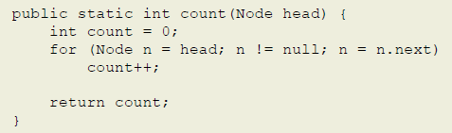
Counting the number of elements in a list

Slide 19
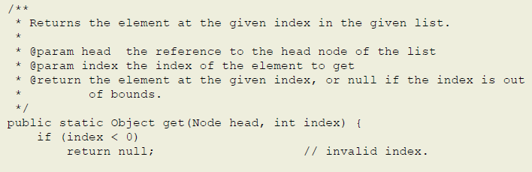
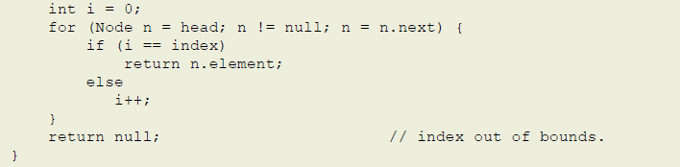
Getting an element given the index into a list

Slide 20
Dummy Headed Doubly Linked Circular lists (DHDLC)
the current implementation of the java.util.LinkedList class in JDK.
It uses a dummy to avoid special cases of inserting into an empty list, or removing the last node from a list of unit size, and it uses double links to allow for iterating in both directions.
The cost of course is the extra space needed to hold the dummy node (minimal cost), and the extra previous link in addition the usual next link for each node.

Slide 21
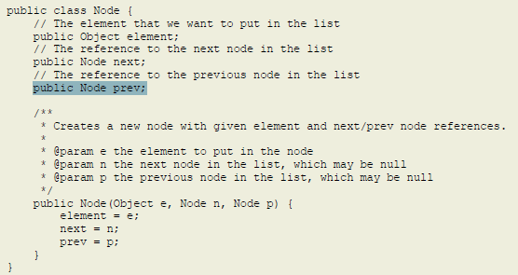

Slide 22
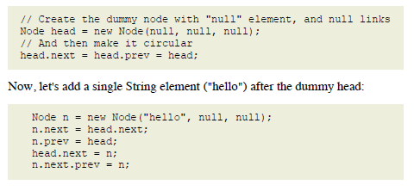

Slide 23

Iterating over the elements

Slide 24
Deleting & Inserting an element
cur.prev.next = cur.next
cur.next.prev = cur.prev
nn.next = cur.next
nn.prev = cur
cur.next.prev = nn
cur.next = nn

